Slide 1
Machine Learning Alberi di Decisione Random Forest
Francesco Pugliese, PhD
neural1977@gmail.com

Slide 2
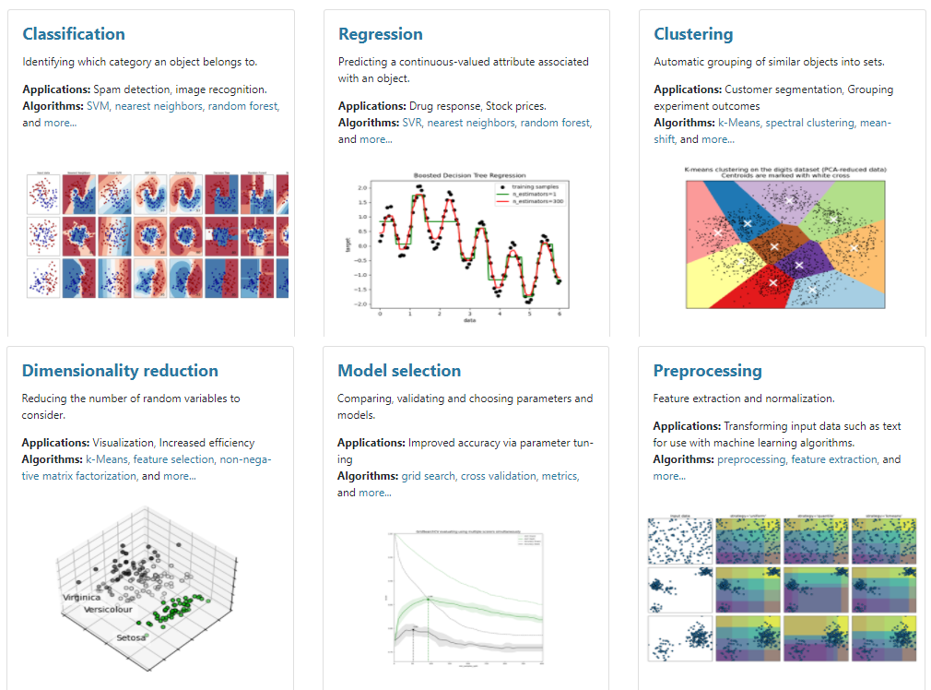
Machine Learning e Universo di Scikit-Learn

Slide 3
Alberi di Decisione
Un albero di decisione è un tool di supporto alle decisioni che usa un modello ad albero per il processo di decision-making process e tutte le possibili conseguenze derivanti dalla decisione.
Esso copre risultati di eventi, riduzione di costo e utilità nelle decisioni.
Ricorda un algoritmo o un diagramma di flusso che contiene solo statement di controllo condizionale.
Ciascun albero di decisione è costituito da 3 parti principali: un nodo root, nodi foglia, e rami.
In un albero di decisione, ciascun nodo interno rappresenta un test o un evento. Diciamo un testa o croce nel lancio di una monetina.
Ciascun ramo rappresenta l’output del test e ciascun nodo rappresenta una label di classe – ossia una decisione presa dopo l’elaborazione di tutti gli attribute.
I percorsi dalla root ai nodi foglia rappresentano le regole di classificazione.

Slide 4
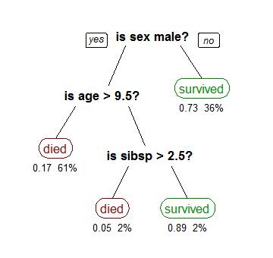
Alberi di Decisione
In un Albero di Decisione, per predire (assegnare) una etichetta di classe per un dato record (riga o data point) possiamo partire dalla radice dell’albero. Confrontiamo I valori dell’attributo radice con gli attributi del record. Sulla base del confronto, seguiamo il ramo corrispondente a quel valore e saltiamo al nodo successivo.
Gli Alberi di Decisione come suggerisce il nome lavorano su un insieme di decisioni derivate dai dati e dal suo comportamento.
Essi non usano un classificatore lineare o un regressore, pertanto le sue prestazioni sono indipendenti dalla natura lineare dei dati o meno.

Slide 5
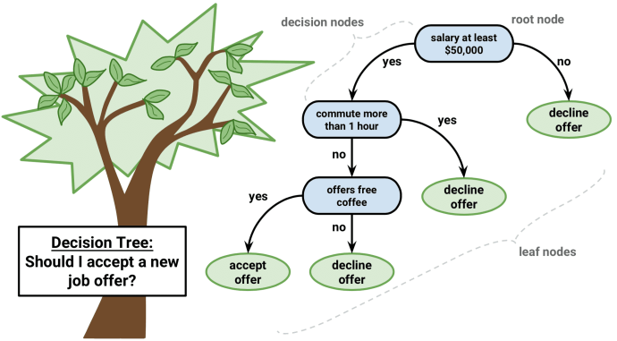
Alcuni Concetti relative agli Alberi di Decisione
Nodo Radice: Esso rappresenta l’intera popolazione o un campio e questo ulteriormente si divide in due o più insiemi omogenei.
Splitting: Rappresenta il processo di divisione di un nodo in due o più sotto-nodi.
Nodo Decisionale: Quando un sotto-nodo si suddivide in ulteriori sotto-nodi, questo prende il nome di nodo decisionale.
Nodi Foglia o Terminali: I nodi che non sono splittati in ulteriori nodi prendono il nome di Nodi Foglia e Nodi Terminali.
Potatura dell’Albero (Pruning): Quando rimuoviamo sotto-nodi da un nodo decisionale, questo processo prende il nome di pruning (potatura). In altre parole è l’opposto del processo di splitting.
Branch / Sotto-Albero: Una sottosezione di un intero albero viene chiamata branch o sotto albero.
Nodo Padre e Nodo Figlio: Un nodo, che viene diviso in sotto-nodi viene chiamato nodo padre mentre I suoi sotto-nodi prendono il nome di nodi figli.

Slide 6
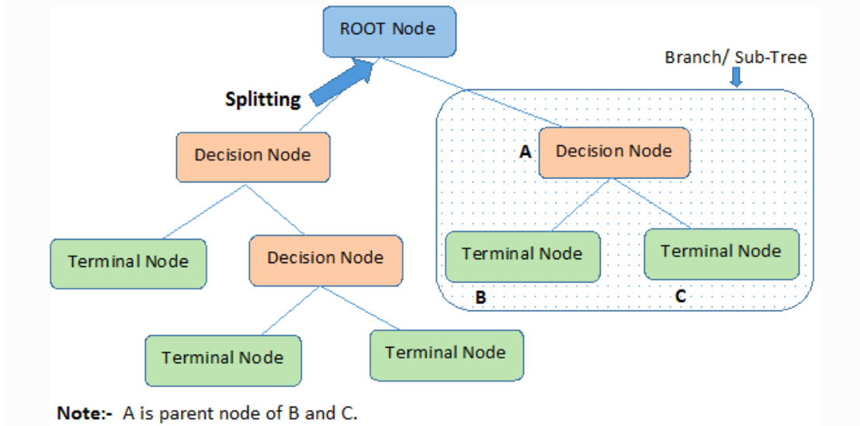
Alcuni Concetti relative agli Alberi di Decisione

Slide 7
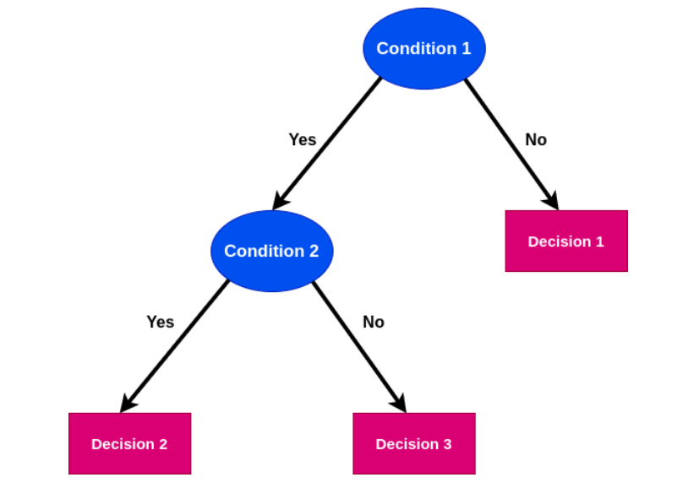
Addestramento di un Albero di Decisione
Gli alberi di decisione usano un algoritmo CART (Classification and Regression Trees). In entrambi i casi, le decisioni sono basate su condizioni su ognuna della feature.
I nodi interni rappresentano le condizioni e i nodi foglia rappresentano la decisione basata sulle condizioni.
Un albero di decisione è una rappresentazione grafica di tutte le possibili soluzioni ad una decisione basata su certe condizioni.
Su ciascuno step o nodo di un albero di decisione, usato per la classificazione, cerchiamo di creare una condizione sulle feature per separare tutte le label o classi contenute nel dataset dalla purezza (purity) più completa.

Slide 8
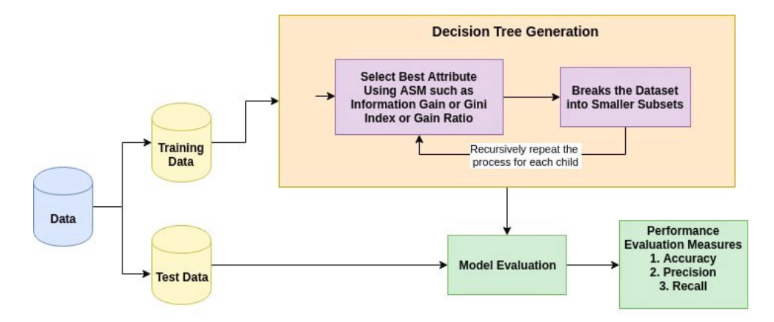
Addestramento di un Albero di Decisione
La creazione dei sotto-nodi incrementa l’omogeneità dei sotto-nodi risultanti. In altre parole, possiamo dire che la purezza del nodo incrementa con la variabile di target presa in esame.
Un albero di decisione divide i nodi su tutte le variabili disponibili e seleziona la ripartizione che sfocia nella maggior parte dei sotto-nodi omogenei.

Slide 9
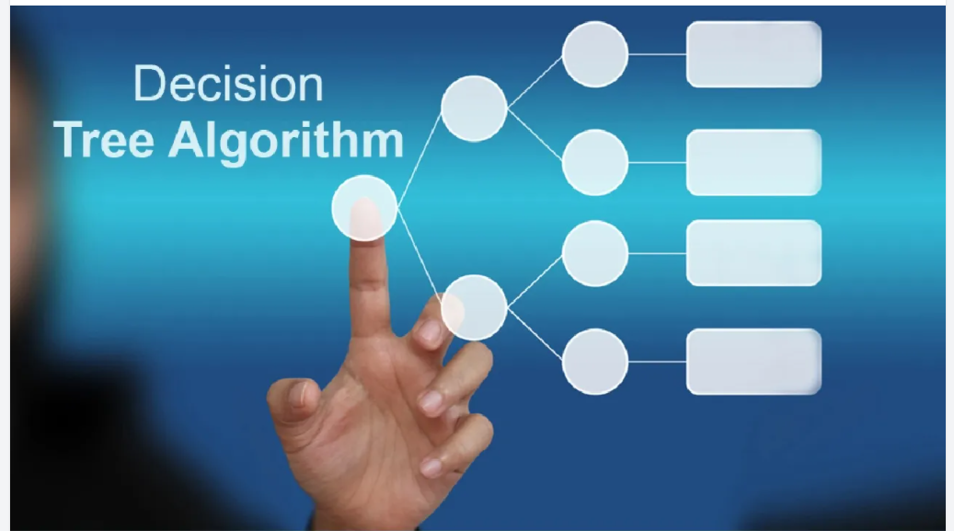
Addestramento di un Albero di Decisione
La selezione di un algoritmo è basata sul tipo di variabili di targer.
Alcuni algoritmi usati negli Alberi di Decisione sono:
ID3 → (estensione di D3)
C4.5 → (successore di ID3)
CART → (Classification And Regression Tree)
CHAID → (Detect dell’interazione automatica Chi-quadrorforms multi-level trees)
MARS → (Curve di regressione adattiva multivariate)

Slide 10
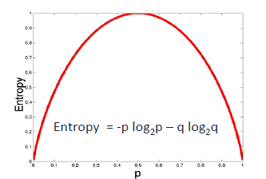



Addestramento degli Alberi di Decisione
Entropia
Guadagno di Informazione
Algoritmo di Addestramento ID3
(Quinlan, 1986)
Passi:
1.Calcolare l’entropia del target.
2.Calculare il Guadagno di Informazione per ciascun attributo. .
3.Scegliere l’attributo con il più grande Guadagno di Informazione possibile, come nodo radice dell’Albero.
4. Ricorsivamente avviare l’algoritmo sui sotto alberi non foglia.
a) Entropia del Target (Entropia che usa la tabella delle frequenze su un solo attributo)
Outlook
b) Entropia su ciascun attributo (Entropia che usa la tabella delle frequenze di due attributi insieme)
Sunny
Rainy
Overcast
Humidity
Windy
Virus
High
True
Rust
Rust
Notes:
Slide 7
Decision tree builds classification or regression models in the form of a tree structure. It breaks down a dataset into smaller and smaller subsets while at the same time an associated decision tree is incrementally developed. The final result is a tree with decision nodes and leaf nodes. A decision node (e.g., Outlook) has two or more branches (e.g., Sunny, Overcast and Rainy). Leaf node (e.g., Play) represents a classification or decision. The topmost decision node in a tree which corresponds to the best predictor called root node. Decision trees can handle both categorical and numerical data.
Algorithm
The core algorithm for building decision trees called ID3 by J. R. Quinlan which employs a top-down, greedy search through the space of possible branches with no backtracking. ID3 uses Entropy and Information Gain to construct a decision tree.
Entropy A decision tree is built top-down from a root node and involves partitioning the data into subsets that contain instances with similar values (homogenous). ID3 algorithm uses entropy to calculate the homogeneity of a sample. If the sample is completely homogeneous the entropy is zero and if the sample is an equally divided it has entropy of one.
o build a decision tree, we need to calculate two types of entropy using frequency tables as follows:
a) Entropy using the frequency table of one attribute:
b) Entropy using the frequency table of two attributes:
Information Gain The information gain is based on the decrease in entropy after a dataset is split on an attribute. Constructing a decision tree is all about finding attribute that returns the highest information gain (i.e., the most homogeneous branches).
Step 1: Calculate entropy of the target.
Step 2: The dataset is then split on the different attributes. The entropy for each branch is calculated. Then it is added proportionally, to get total entropy for the split. The resulting entropy is subtracted from the entropy before the split. The result is the Information Gain, or decrease in entropy.
Step 3: Choose attribute with the largest information gain as the decision node.
Step 4a: A branch with entropy of 0 is a leaf node.
Step 4b: A branch with entropy more than 0 needs further splitting.
Step 5: The ID3 algorithm is run recursively on the non-leaf branches, until all data is classified.

Slide 11
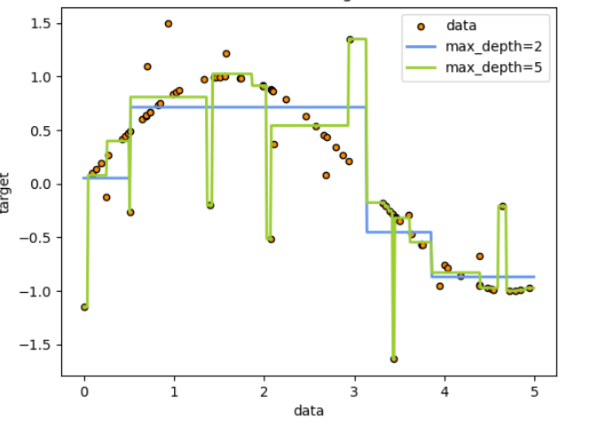
Algoritmo di addestramento degli Alberi di Decisione ID3
Passi dell’algoritmo ID3 (Iterative Dichotomiser 3) usato per generare un albero di decisione da un dataset. ID3 è il precursore dell’algoritmo C4.5:
Inizia con un insieme d’origine S come nodo radice.
Per ciascuna iterazione dell’algoritmo, esso itera attraverso gli attribute mai usati di S e calcola Entropy(H) e Information Gain(IG) di questo attributo.
Esso poi selezione l’attributo che ha la minore entropia o il più grande Guadagno d’Informazione.
4. L’insieme S è poi suddiviso (splitting) dall’attributo selezionato che funge da spartiacque al fine di produrre un più sottoinsiemi di dati.
5. L’algoritmo continua ricorsivamento su ciascun sottoinsieme, considerando solo attribute mai selezionati prima.

Slide 12
Algoritmo di Addestramento di Alberi di Decisione ID3
Per esempio, un nodo può essere splittato in nodi figli a seconda dei sottoinsiemi della popolazione le cui età sono meno di 50, tra 50 e 100 e più grandi di 100. L’algoritmo continua la ricorsione su ciascun sottoinsieme, considerando solo attributi mai selezionati prima.
La Ricorsione su un insieme si ferma quando:
1) Ogni elemento nel sottoinsieme appartiene alla medesima classe: in questo caso il nodo viene convertito in nodo foglia ed etichettato con la classe degli esempi.
2) Non ci sono più attribute da selezionare, ma gli esempi ancora non appartengono tutti alla stessa classe. In questo caso, il nodo è reso un nodo foglia ed etichettato con la classe maggioritaria degli esempi nel sotto insieme.
3) Non ci sono più esempi nel sottoinsieme, il che accade quando nessun esempio nell’insieme padre è stato trovato per matchare uno specific valore dell’attributo selezionato.

Slide 13
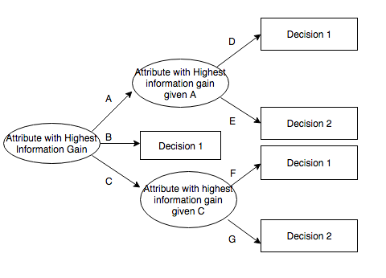
Addestramento degli Alberi di Decisione

Slide 14
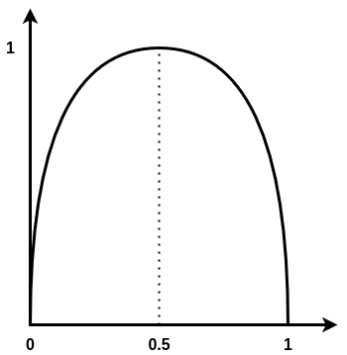
Addestramento degli Alberi di Decisione: Entropia
Entropia: essa fornisce la misura dell’impurità o casualità nei dati. Essa è data dalla seguente formula:
Entropy= — P(class 1) x Log(P(class 1)) — P(class 2) x Log(P(class 2)) dove P denota la probabilità.
If there are two classes, class 1 and class 2, of equal numbers, i.e, the number of entries of class 1 is equal to the number of entries of class 2, and we randomly select an entry, it will belong to any class 1 or 2 with a 50% probability each. In such cases, the entropy will be high.
If a certain dataset has all data belonging to either class 1 or class 2, the entropy obtained is 0, as in that case P(class1) or P(class2) will be equal to 0. If P(class1)=0 then P(class2) should be equal to 1.So, it is evident that the entropy will be high if we have impure or mixed class labels in a dataset.
The beside diagram shows the variation of the probability of labels with entropy. We can see if the probability of a label is 0.5, the entropy is the maximum.

Slide 15
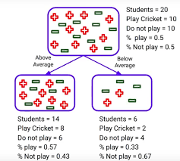
Decision trees Training: Information Gain
In other words Information gain is used to decide which feature to split on at each step in building the tree. Simplicity is best, so we want to keep our tree small. To do so, at each step we should choose the split that results in the purest daughter nodes. A commonly used measure of purity is called information. For each node of the tree, the information value measures how much information a feature gives us about the class. The split with the highest information gain will be taken as the first split and the process will continue until all children nodes are pure, or until the information gain is 0.

Slide 16
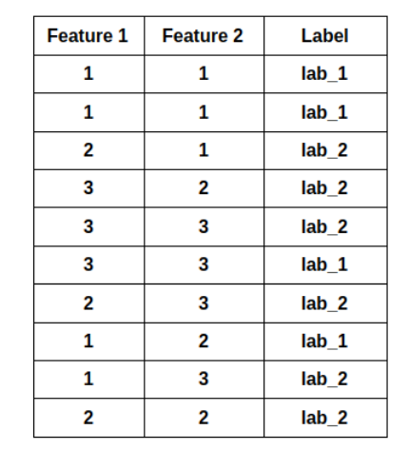
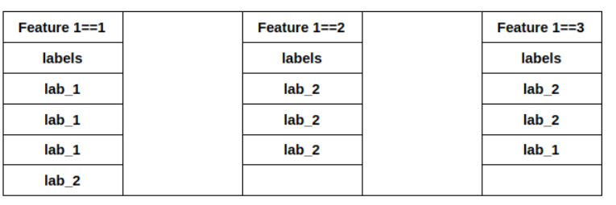
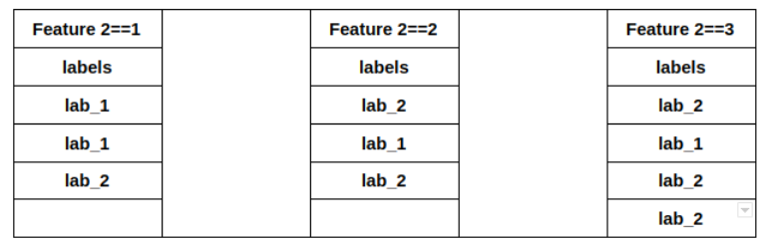
Decision trees Training: Information Gain
Information Gain: The information gain is the decrease in the entropy after the dataset is split on the basis of an attribute. Constructing a decision tree depends on finding the attribute that returns the highest information gain. It helps in choosing which feature or attribute will be used to create the deciding internal node at a particular point.
Information gain=Entropy(s) — [(Weighted average) x (Entropy of each feature)
Information Gain Ft1= 0.313
Information Gain Ft2 = 0.1

Slide 17
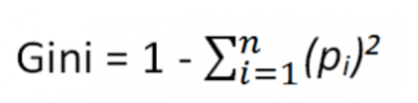
Decision trees Training: GINI Impurity
Pure
Pure means, in a selected sample of dataset all data belongs to same class (PURE).
Impure
Impure means, data is mixture of different classes.
Definition of Gini Impurity
Gini Impurity is a measurement of the likelihood of an incorrect classification of a new instance of a random variable, if that new instance were randomly classified according to the distribution of class labels from the data set.
If our dataset is Pure then likelihood of incorrect classification is 0. If our sample is mixture of different classes then likelihood of incorrect classification will be high.
When you use the Gini index as the criterion for the algorithm to select the feature for the root node.,The feature with the least Gini index is selected.

Slide 18
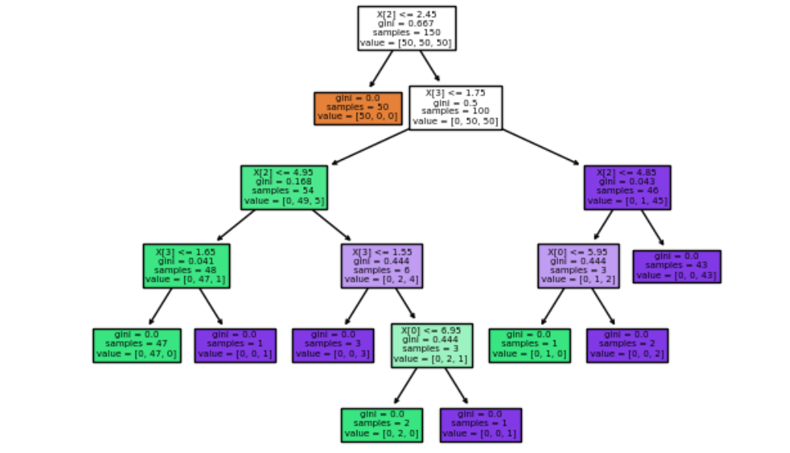
Decision trees Training
Notes:
Slide 7
Decision tree builds classification or regression models in the form of a tree structure. It breaks down a dataset into smaller and smaller subsets while at the same time an associated decision tree is incrementally developed. The final result is a tree with decision nodes and leaf nodes. A decision node (e.g., Outlook) has two or more branches (e.g., Sunny, Overcast and Rainy). Leaf node (e.g., Play) represents a classification or decision. The topmost decision node in a tree which corresponds to the best predictor called root node. Decision trees can handle both categorical and numerical data.
Algorithm
The core algorithm for building decision trees called ID3 by J. R. Quinlan which employs a top-down, greedy search through the space of possible branches with no backtracking. ID3 uses Entropy and Information Gain to construct a decision tree.
Entropy A decision tree is built top-down from a root node and involves partitioning the data into subsets that contain instances with similar values (homogenous). ID3 algorithm uses entropy to calculate the homogeneity of a sample. If the sample is completely homogeneous the entropy is zero and if the sample is an equally divided it has entropy of one.
o build a decision tree, we need to calculate two types of entropy using frequency tables as follows:
a) Entropy using the frequency table of one attribute:
b) Entropy using the frequency table of two attributes:
Information Gain The information gain is based on the decrease in entropy after a dataset is split on an attribute. Constructing a decision tree is all about finding attribute that returns the highest information gain (i.e., the most homogeneous branches).
Step 1: Calculate entropy of the target.
Step 2: The dataset is then split on the different attributes. The entropy for each branch is calculated. Then it is added proportionally, to get total entropy for the split. The resulting entropy is subtracted from the entropy before the split. The result is the Information Gain, or decrease in entropy.
Step 3: Choose attribute with the largest information gain as the decision node.
Step 4a: A branch with entropy of 0 is a leaf node.
Step 4b: A branch with entropy more than 0 needs further splitting.
Step 5: The ID3 algorithm is run recursively on the non-leaf branches, until all data is classified.

Slide 19
Decision trees
Can be a powerful machine learning algorithm for classification and regression.
Classification tree works on the target to classify if it was a heads or a tail.
Regression trees are represented in a similar manner, but they predict continuous values like house prices in a neighbourhood.
The best part about decision trees:
Handle both numerical and categorical data
Handle multi-output problems
Decision trees require relatively less effort in data preparation
Nonlinear relationships between parameters do not affect tree performance

Slide 20
Applications of Decision trees
Selecting a flight to travel
Predicting high occupancy dates for hotels
Number of drug stores nearby was particularly effective for a client X
Cancer vs non-cancerous cell classification where cancerous cells are rare say 1%
Suggest a customer what car to buy

Slide 21
Random Forest
Is an ensemble learning technique about classification, regression and other operations that depend on a multitude of decision trees at the training time.
They are fast, flexible, represent a robust approach to mining high-dimensional data and are an extension of classification and regression decision trees we talked about above.
Ensemble learning, in general, can be defined as a model that makes predictions by combining individual models.
The ensemble model tends to be more flexible with less bias and less variance.
Ensemble Learning has two popular methods as:
Bagging: Each individual tree to randomly sample from the dataset and trained by s random subset of data, resulting in different trees
Boosting: Each individual tree /model learns from mistakes made by the previous model and improves

Slide 22
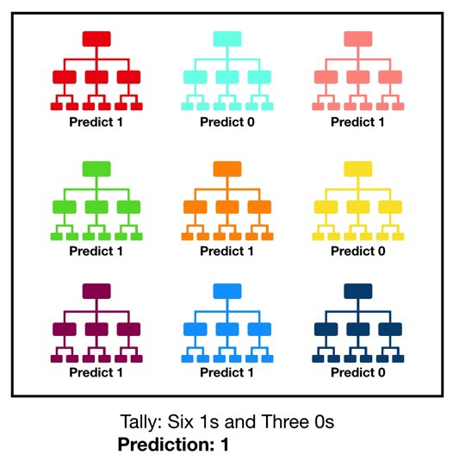
Random Forest
Random forest, like its name implies, consists of a large number of individual decision trees that operate as an ensemble. Each individual tree in the random forest spits out a class prediction and the class with the most votes becomes our model’s prediction
A large number of relatively uncorrelated models (trees) operating as a committee will outperform any of the individual constituent models.
Bagging (Bootstrap Aggregation) — Decisions trees are very sensitive to the data they are trained on — small changes to the training set can result in significantly different tree structures. Random forest takes advantage of this by allowing each individual tree to randomly sample from the dataset with replacement, resulting in different trees. This process is known as bagging.

Slide 23
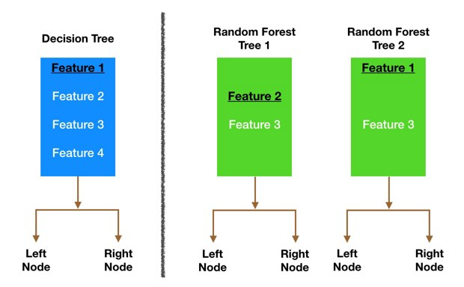
Random Forest
We are not subsetting the training data into smaller chunks and training each tree on a different chunk. Rather, if we have a sample of size N, we are still feeding each tree a training set of size N (unless specified otherwise). But instead of the original training data, we take a random sample of size N with replacement. For example, if our training data was [1, 2, 3, 4, 5, 6] then we might give one of our trees the following list [1, 2, 2, 3, 6, 6]. Notice that both lists are of length six and that “2” and “6” are both repeated in the randomly selected training data we give to our tree (because we sample with replacement).

Slide 24

Random Forest
Feature Randomness — In a normal decision tree, when it is time to split a node, we consider every possible feature and pick the one that produces the most separation between the observations in the left node vs. those in the right node. In contrast, each tree in a random forest can pick only from a random subset of features. This forces even more variation amongst the trees in the model and ultimately results in lower correlation across trees and more diversification.

Slide 25
Random Forest
Random forest run times are quite fast.
They are pretty efficient in dealing with missing and incorrect data.
On the negatives, they cannot predict beyond the defined range in the training data, and that they may over-fit data sets that are particularly noisy.
A random forest should have a number of trees between 64–128 trees.
Random Forest vs Decision Tree:
Random Forest is essentially a collection of Decision Trees.
A decision tree is built on an entire dataset, using all the features/variables of interest, whereas a random forest randomly selects observations/rows and specific features/variables to build multiple decision trees from and then averages the results.

Slide 26
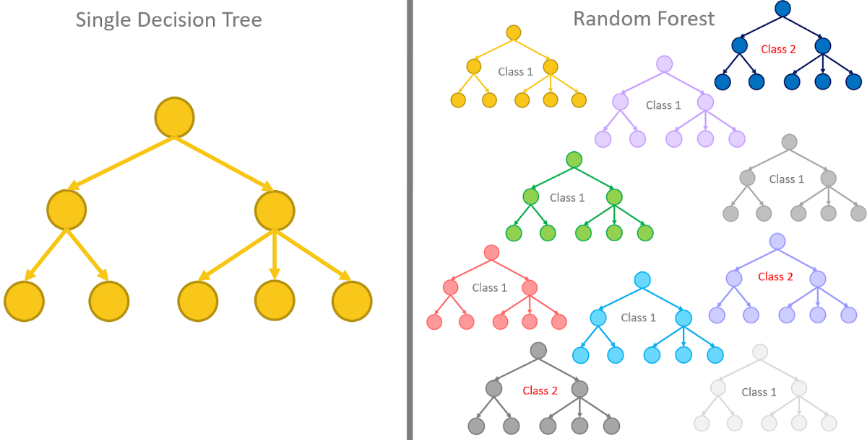
Random Forest

Slide 27
Applications of Random Forest
Fraud detection for bank accounts, credit card
Detect and predict the drug sensitivity of a medicine
Identify a patient’s disease by analysing their medical records
Predict estimated loss or profit while purchasing a particular stock

Slide 28
References
Kingsford, C., & Salzberg, S. L. (2008). What are decision trees?. Nature biotechnology, 26(9), 1011-1013.
Cheng, J., Fayyad, U. M., Irani, K. B., & Qian, Z. (1988). Improved decision trees: a generalized version of id3. In Machine Learning Proceedings 1988 (pp. 100-106). Morgan Kaufmann.
Oshiro, T. M., Perez, P. S., & Baranauskas, J. A. (2012, July). How many trees in a random forest?. In International workshop on machine learning and data mining in pattern recognition (pp. 154-168). Springer, Berlin, Heidelberg.

Slide 29
Francesco Pugliese

